Slide 1

GCSE: Congruent Triangles
Dr J Frost (jfrost@tiffin.kingston.sch.uk)
www.drfrostmaths.com
GCSE Revision Pack Refs: 169, 170
“Understand and use SSS, SAS, ASA and RHS conditions to prove the congruence of triangles using formal arguments.”
Associated Resources: GCSEQuestions-Congruence.doc
Last modified: 31st August 2015

Slide 2
What is congruence?
These triangles are similar.
These triangles are congruent.
?
?
They are the same shape.
They are the same shape and size.
(Only rotation and flips allowed)

Slide 3
Starter
Suppose two triangles have the side lengths. Do the triangles have to be congruent?
Yes, because the all the angles are determined by the sides.
Would the same be true if two quadrilaterals had the same lengths?
No. Square and rhombus have same side lengths but are different shapes.
?
?
In pairs, determine whether comparing the following pieces of information would be sufficient to show the triangles are congruent.
a
b
c
d
3 sides the same.
Two sides the same and angle between them.
All angles the same.
Two angles the same and a side the same.
Two sides the same and angle not between them.
✓Congruent
?
?
?
?
✓Congruent
× Not necessarily Congruent (but Similar)
✓Congruent
× Not necessarily Congruent (we’ll see why)

Slide 4
Proving congruence
GCSE papers will often ask for you to prove that two triangles are congruent.
There’s 4 different ways in which we could show this:
!
a
?
SAS
Two sides and the included angle.
b
?
ASA
Two angles and a side.
c
?
SSS
Three sides.
d
?
RHS
Right-angle, hypotenuse and another side.

Slide 5
Proving congruence
Why is it not sufficient to show two sides are the same and an angle are the same if the side is not included?
Try and draw a triangle with the same side lengths and indicated angle, but that is not congruent to this one.
Click to Reveal
In general, for “ASS”, there are always 2 possible triangles.

Slide 6
What type of proof
For triangle, identify if showing the indicating things are equal (to another triangle) are sufficient to prove congruence, and if so, what type of proof we have.
This angle is known from the other two.
⎦
SSS
SAS
⎦
SSS
SAS
⎦
SSS
SAS
⎦
SSS
SAS
ASA
RHS
ASA
RHS
ASA
RHS
ASA
RHS
⎦
SSS
SAS
⎦
SSS
SAS
⎦
SSS
SAS
⎦
SSS
SAS
ASA
RHS
ASA
RHS
ASA
RHS
ASA
RHS
Notes:
Ask why the features not sufficient for congruence are not sufficient.

Slide 7
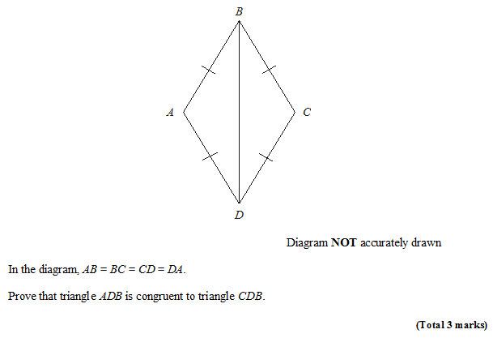
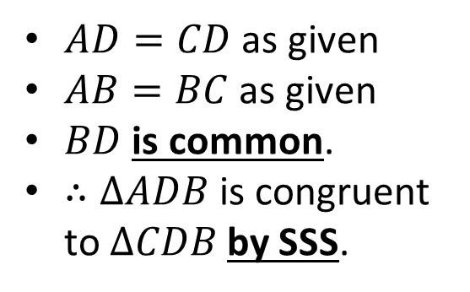
Example Proof
Nov 2008 Non Calc
STEP 1: Choose your appropriate proof (SSS, SAS, etc.)
STEP 2: Justify each of three things.
STEP 3: Conclusion, stating the proof you used.
Solution:
$AD=CD$ as given
$AB=BC$ as given
$BD$ is common.
$∴ΔADB$ is congruent to $ΔCDB$ by SSS.
?
Bro Tip: Always start with 4 bullet points: three for the three letters in your proof, and one for your conclusion.

Slide 8





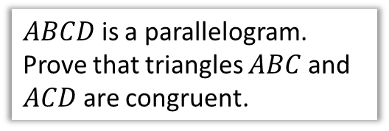


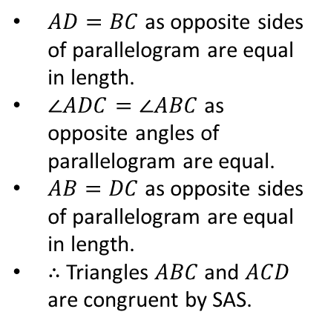


Check Your Understanding
$$A$$
$$B$$
$ABCD$ is a parallelogram. Prove that triangles $ABC$ and $ACD$ are congruent.
(If you finish quickly, try proving another way)
$$D$$
$$C$$
Using $SSS$:
Using $SAS$:
Using $ASA$:
?
$AD=BC$ as opposite sides of parallelogram are equal in length.
$∠ADC=∠ABC$ as opposite angles of parallelogram are equal.
$AB=DC$ as opposite sides of parallelogram are equal in length.
$∴$ Triangles $ABC$ and $ACD$ are congruent by SAS.
?
$AC$ is common.
$AD=BC$ as opposite sides of parallelogram are equal in length.
$AB=DC$ for same reason.
$∴$ Triangles $ABC$ and $ACD$ are congruent by SSS.
?
$∠ADC=∠ABC$ as opposite angles of parallelogram are equal.
$AB=DC$ as opposite sides of parallelogram are equal in length.
$∠DAC=∠ACB$ as alternate angles are equal.
$∴$ Triangles $ABC$ and $ACD$ are congruent by ASA.

Slide 9
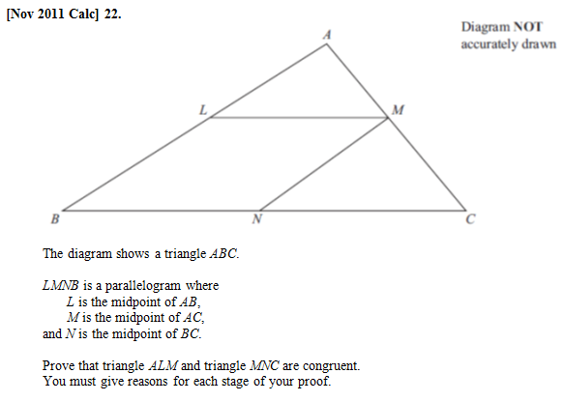
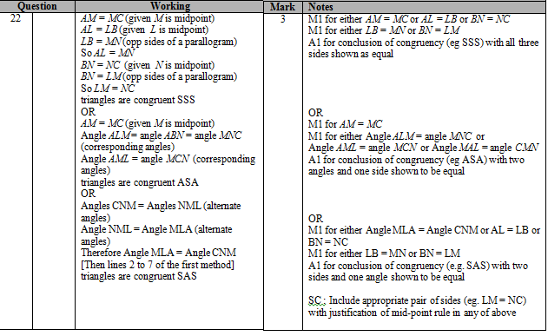
Exercises
(if multiple parts, only do (a) for now)
NOTE
Q1
?

Slide 10
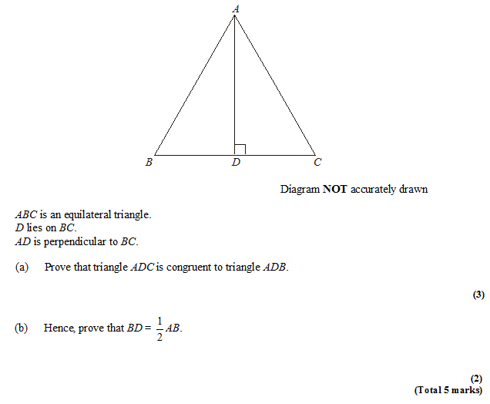
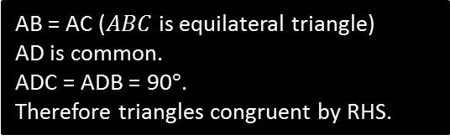
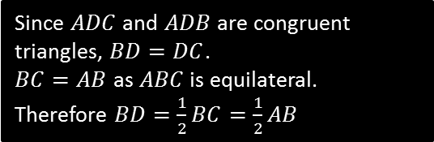
Exercises
Q2
?
AB = AC ($ABC$ is equilateral triangle)
AD is common.
ADC = ADB = 90$°$.
Therefore triangles congruent by RHS.
Since $ADC$ and $ADB$ are congruent triangles, $BD=DC$.
$BC=AB$ as $ABC$ is equilateral.
Therefore $BD=\frac{1}{2}BC=\frac{1}{2}AB$
?

Slide 11
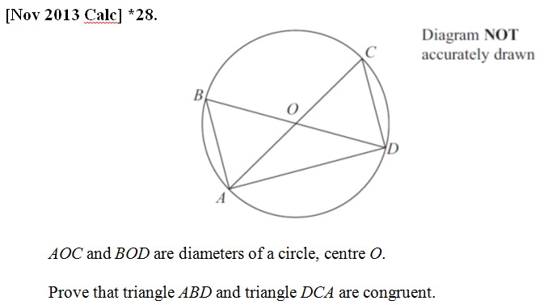
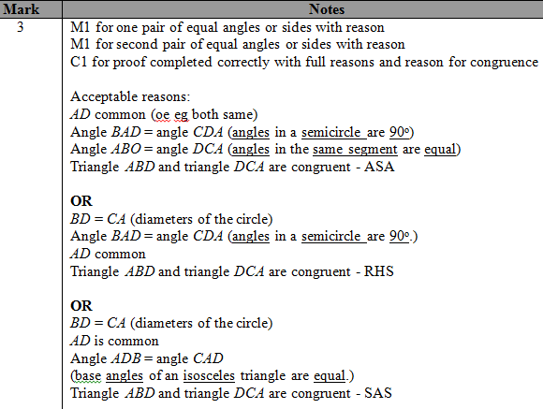
Congruent Triangles
Q3
?

Slide 12
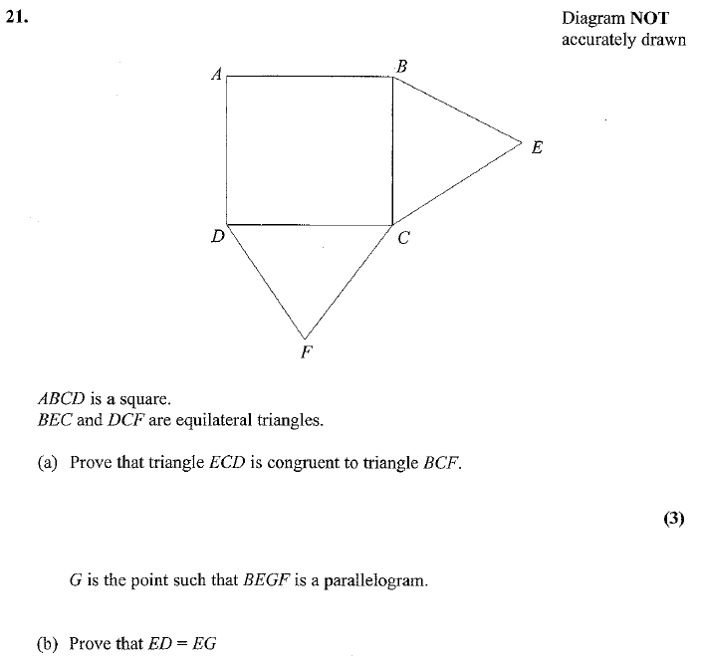
Exercises
Q4
BC = CE equal sides
CF = CD equal sides
BCF = DCE = 150º
BFC is congruent to ECD by SAS.
?
?
So BF=ED (congruent triangles)
BF = EG ( opp sides of parallelogram)
(2)

Slide 13
Check Your Understanding
What are the four types of congruent triangle proofs?
SSS, SAS, ASA (equivalent to AAS) and RHS.
What should be the structure of our proof?
Justification of each of the three letters, followed by conclusion in which we state which proof type we used.
What kinds of justifications can be used for sides and angles?
Circle Theorems, ‘common’ sides, alternate/corresponding angles, properties of parallelograms, sides/angles of regular polygon are equal.
?
?
?

Slide 14
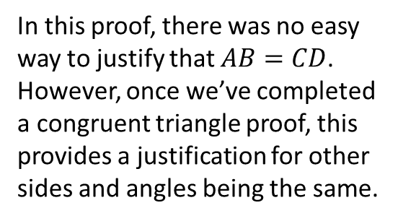
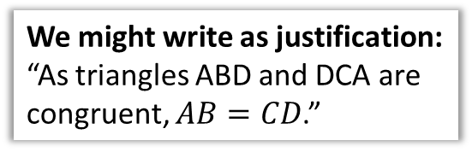
Using completed proof to justify other sides/angles
In this proof, there was no easy way to justify that $AB=CD$.
However, once we’ve completed a congruent triangle proof, this provides a justification for other sides and angles being the same.
We might write as justification:
“As triangles ABD and DCA are congruent, $AB=CD$.”

Slide 15
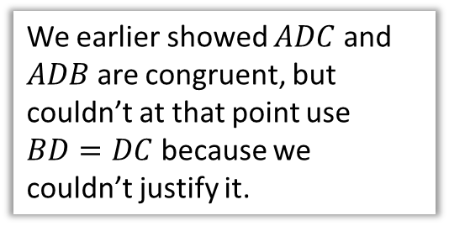
Exercises
Q2
We earlier showed $ADC$ and $ADB$ are congruent, but couldn’t at that point use $BD=DC$ because we couldn’t justify it.
AB = AC ($ABC$ is equilateral triangle)
AD is common.
ADC = ADB = 90$°$.
Therefore triangles congruent by RHS.
Since $ADC$ and $ADB$ are congruent triangles, $BD=DC$.
$BC=AB$ as $ABC$ is equilateral.
Therefore $BD=\frac{1}{2}BC=\frac{1}{2}AB$
?

Slide 16
Exercises
Q4
BC = CE equal sides
CF = CD equal sides
BCF = DCE = 150º
BFC is congruent to ECD by SAS.
?
So BF=ED (congruent triangles)
BF = EG ( opp sides of parallelogram)
(2)

